Slide 1
Introduction to Fisheries Acoustics and importance of calibration
Teresa Silva

Slide 2
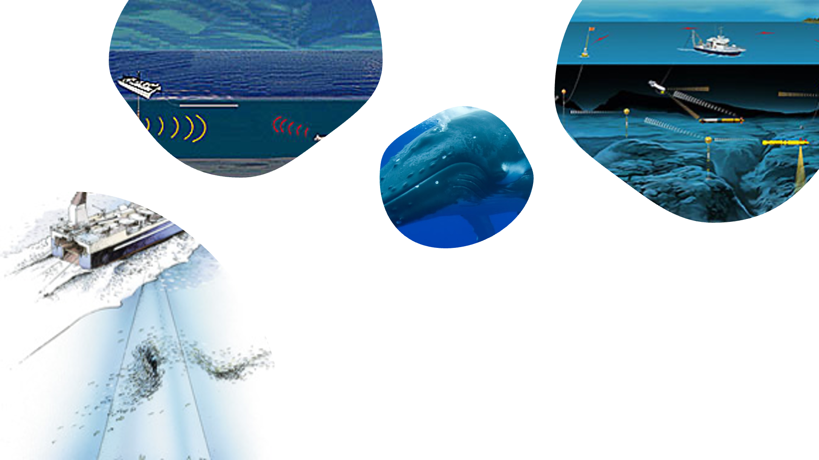

Slide 3
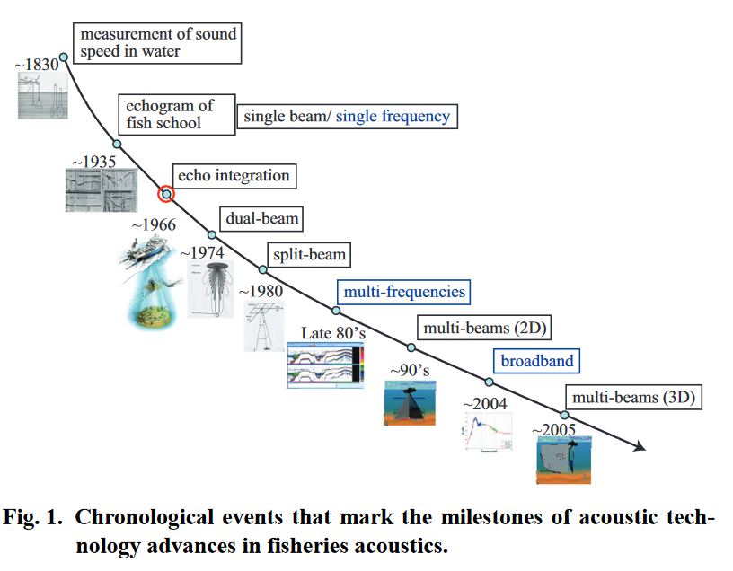
What is Fisheries Acoustics?
Use of sound waves to detect and quantify fish populations and their habitats.
Non-invasive method for monitoring aquatic ecosystems.
Dezhang Chu (2011) Journal of Marine Science and Technology, Vol. 19, No. 3, pp. 245-252

Slide 4
Key components of Fisheries Acoustics
Acoustic Equipment
Echosounders: devices that emit sound pulses and receive echoes.
Hydrophones: underwater microphones for detecting sound.
Transducers: convert electrical signals into sound waves and vice versa.

Slide 5
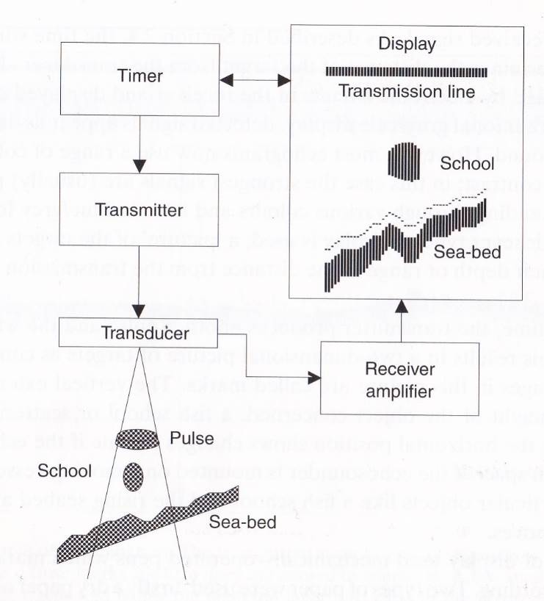
Scientific echosounder
Simmonds & McLennan 2005

Slide 6
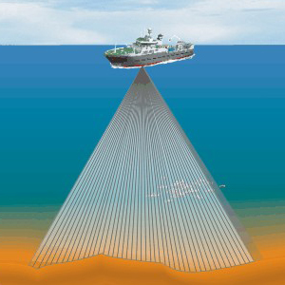
Applications of Fisheries Acoustics
Fish Stock Assessment
Monitoring fish populations and biomass.
- Estimating fish population sizes and distributions.
- Informing sustainable fisheries management.
Habitat Mapping
- Identifying critical habitats for fish species.
- Monitoring changes in habitat over time. -
Behavioral Studies
- Observing fish behavior in response to environmental changes. - Understanding migration patterns and spawning activities.
Data Collection - Deployment of acoustic equipment from boats or fixed platforms.
- Collection of acoustic signals reflected from fish and other underwater objects.
Multibeam echosounder

Slide 7
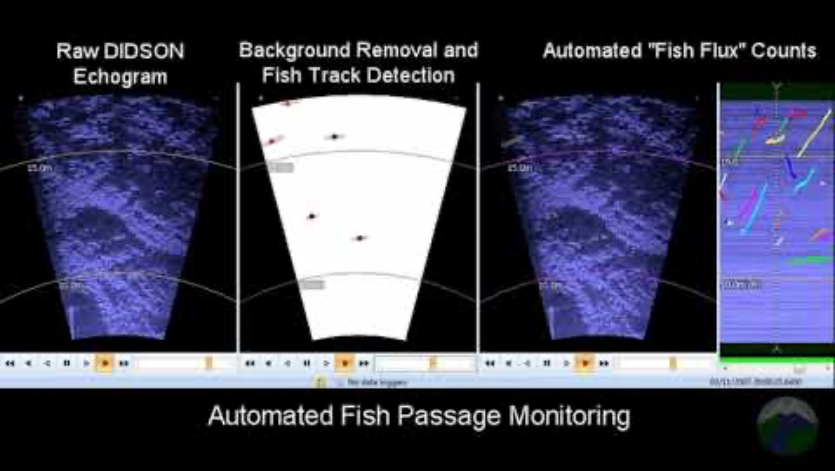
Acoustic cameras
DIDSON
https://www.youtube.com/watch?v=h-1wrY3VdCE
Automated DIDSON and ARIS Sonar Processing using Echoview Software
Notes:
https://www.milnetechnologies.ca/didson.htm

Slide 8
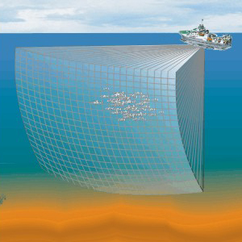
sonar
Notes:
Provides an acoustic matrix of stabilized and calibrated beams for biomass estimation, fish school characterization and behaviour studies.
The transducer array is normally mounted on a drop keel, which allows it to look horizontally.
The Simrad MS70 allows characterization and volume estimation of a school of fish using only one single transmission.
Schools of fish can be tracked, followed, and studied using multiple consecutive transmissions.
As a consequence of the horizontal transmission using narrow beams, the MS70 allows you to detect and characterize schools of fish even very close to the sea surface.

Slide 9
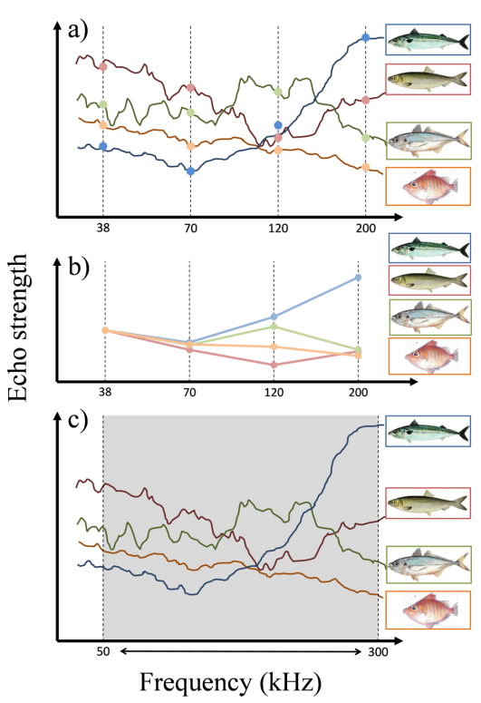
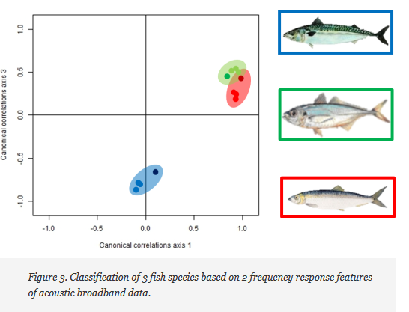
Broadband
https://www.wur.nl/en/project/Fish-species-identification-from-acoustic-broadband-data.htm

Slide 10

Acoustic Principles in Fisheries
Sound Propagation in Water
Sound travels faster in water than in air (approximately 1500 m/s).
Influenced by temperature, salinity, and pressure.
Attenuation: loss of sound energy as it travels through water.
Acoustic Backscatter
Reflection of sound waves off fish and other objects.
Backscatter strength depends on fish size, shape, and orientation.
Used to estimate fish density and biomass.

Slide 11
Importance of Calibration
Ensures accuracy and reliability of acoustic measurements.
Compensates for environmental factors affecting sound propagation.
Essential for comparing data across different surveys and time periods.

Slide 12
Calibration Techniques
Standard Calibration Methods
Use of reference targets (e.g., spheres) with known acoustic properties.
Calibration of transducers to ensure consistent output.
In-situ Calibration
Calibration performed in the field using known targets.
Accounts for environmental conditions during data collection.
Post-Processing Calibration
Adjusting data based on calibration results.
Correcting for system drift and environmental changes.

Slide 13
Consequences of Poor Calibration
Data Inaccuracy
Misestimation of fish populations and distributions.
Inconsistent results across different surveys.
Misguided Management Decisions
Inaccurate data can lead to overfishing or under-protection of fish stocks.
Impacts on conservation efforts and ecosystem health.

Slide 14
NASC and Gain Relationship
Understanding NASC (Nautical Area Scattering Coefficient)
NASC represents the integrated backscatter from fish in a nautical square mile.
Directly proportional to fish density and biomass.
Formula: NASC = ∫ sv dA (integration of volume backscattering coefficient)
Gain and NASC Relationship
Gain settings affect the received signal strength.
Improper gain calibration leads to systematic bias in NASC values.
Example: A 1 dB gain error can result in ~26% error in biomass estimates.

Slide 15
Case Studies
Successful Calibration
A fisheries survey that accurately estimated fish biomass due to proper calibration.
Resulted in effective management strategies for sustainable fishing.
Poor Calibration Consequences
A survey that underestimated fish populations due to lack of calibration.
Led to overfishing and subsequent population decline.

Slide 16
Conclusion
Summary
Fisheries acoustics is a vital tool for monitoring aquatic ecosystems.
Calibration is crucial for ensuring accurate and reliable data.
Future Directions
Advancements in technology for improved acoustic measurements.
Integration with other monitoring methods for comprehensive ecosystem assessments.

Slide 17
Key References and Publications
Essential Reading in Fisheries Acoustics
Simmonds, J. & MacLennan, D.N. (2005). Fisheries Acoustics: Theory and Practice (2nd ed.). Blackwell Science.
Foote, K.G. (1987). Fish target strengths for use in echo integrator surveys. Journal of the Acoustical Society of America, 82(3), 981-987.
Demer, D.A. et al. (2015). Calibration of acoustic instruments. ICES Cooperative Research Report No. 326.

Slide 18
Thank You

